Slide 1


Presentation by: Sibiya Kudzanai
07-Dec-2023

Slide 2

Outline
This report is structured as follows (in that order):
Executive Summary.
Introduction.
Methodology.
Results.
Conclusion.
Appendix.

Slide 3
Executive Summary
Summary of methodologies
Data Collection through SpaceX API, and Web Scrapping
Data Wrangling and Cleaning – missing valves, consistent formatting of data types.
Exploratory Data Analysis with SQL and Python Libraries – Descriptive statistics about the dataset.
Data Visualization - interactive viz, using Folium.
Machine Learning Prediction
Summary of all results
Attached herein are screenshots and commentary of the meaning of the findings.

Slide 4
Introduction
Project background and context
This is a report on capstone project conducted on SpaceX dataset to predict if the Falcon 9 first stage will land successfully. SpaceX advertises Falcon 9 rocket launches on its website with a cost of $62 million dollars/each. Other providers cost the same upward of $165 million/each, much of the savings is because SpaceX can reuse the first stage. If we can determine if the first stage will land, we can determine the cost of a launch. This information can be used by an alternate company that wants to bid against SpaceX for a rocket launch.
Problems you want to find answers
The project’s objective was to answer the below problem statements or questions
What are the factors that determine if a rocket landing is successful?
What is the interaction amongst features that determine the success rate of a successful rocket landing.
What operating conditions need to be in place for a successful rocket landing.

Slide 5


Slide 6
Methodology
Executive Summary
Data collection was done through SpaceX API and web scraping from Wikipedia.
The collected data was cleaned. This involved missing valves and formatting of same data for consistency.
To understand the structure of the dataset, Exploratory Data Analysis (EDA) and data visualization were conducted.
Folium and Plotly Dash were used to present interactive visuals.
Lastly, predictive analysis using classification models was done.

Slide 7
Data Collection
GET Request was used to collect data together with SpaceX API.
Raw data from SpaceX was decoded a Json using .json() function call and was turned into a pandas Data Frame using.
Data was then cleaned – checking for missing data, and fill in missing values where necessary – with averages.
Web scraping from Wikipedia was also carried out to get Falcon 9 launch records. This was done using BeautifulSoup.

Slide 8
Data Collection – SpaceX API
Below is a link to the GitHub URL that has all of the details on how data was collected:
https://github.com/Sibiya-K/IBM-Applied-Data-Science-Capstone.git
Made a GET Request to the SpaceX API.
Received and inspected the data.
Data wrangling.
Data Formatting and cleaning.
Saving the cleaned data for further analysis.

Slide 9
Data Collection - Scraping
https://github.com/Sibiya-K/IBM-Applied-Data-Science-Capstone.git
Request the Falcon 9 Launch Wiki page from its URL
Extract all column names from the HTML table header
Find all tables on the wiki page
Create a data frame by parsing the launch HTML tables.

Slide 10
Data Wrangling
Carried out Exploratory Data Analysis to establish the training labels.
No. of launches at each site, and No. of occurrence of each orbits were calculated.
Created landing outcome label from outcome column and exported the results to csv file.
https://github.com/Sibiya-K/IBM-Applied-Data-Science-Capstone.git

Slide 11
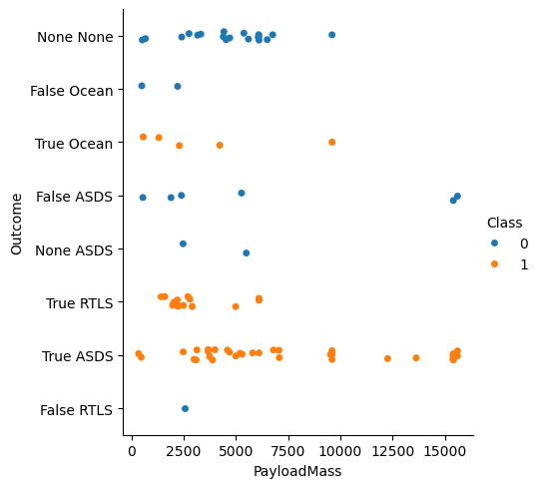
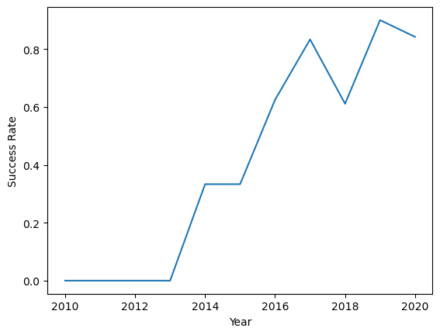
EDA with Data Visualization
Explore and visualized the relationship between; Flight Number vs. Launch Site, Payload and Launch Site, success rate of each orbit type, Flight Number and Orbit type, Payload and Orbit type and visualized the launch success yearly trend. (https://github.com/Sibiya-K/IBM-Applied-Data-Science-Capstone.git)

Slide 12
EDA with SQL
Used SQL in Jupyter notebook to analyze the SpaceX dataset. Queried the SpaceX dataset using SQL to answer the following;
Display the names of the unique launch sites in the space mission,
5 records where launch sites begin with the string 'CCA’
Total payload mass carried by boosters launched by NASA (CRS)
The average payload mass carried by booster version F9 v1.1,
The date when the first successful landing outcome in ground pad was achieved, the names of the boosters which have success in drone ship and have payload mass greater than 4000 but less than 6000
The total number of successful and failure mission outcomes and the names of the booster versions which have carried the maximum payload mass.
The records on the month names, failure landing outcomes in drone ship ,booster versions, launch site for the months in year 2015.
Ranking the count of landing outcomes (such as Failure (drone ship) or Success (ground pad)) between the date 2010-06-04 and 2017-03-20, in descending order.
(https://github.com/Sibiya-K/IBM-Applied-Data-Science-Capstone.git)

Slide 13
Build an Interactive Map with Folium
Marked all launch sites, added map objects/markers to mark the success or failure of launches for each site on the map.
Assigned the feature launch outcomes (failure or success) to class 0 and 1.i.e., 0 for failure, and 1 for success.
Using the color-labeled marker clusters, launch sites with relatively high success rate were identified.
Calculated the distances between a launch site to its proximities, and my findings are about the launch sites are;
#Close proximity to coastline - to be able to fly over the ocean during launch.
#Close proximity to highways and railways - for easily transport required people, and heavy cargo that may be required.
#Not close proximity to cities - if close to cities the launch poses as a danger to the people.
(https://github.com/Sibiya-K/IBM-Applied-Data-Science-Capstone.git)

Slide 14
Build a Dashboard with Plotly Dash
Built interactive dashboard with Plotly dash
Plotted pie charts showing the total launches by a certain sites
Plotted scatter graph showing the relationship with Outcome and Payload Mass (Kg) for the different booster version.
(https://github.com/Sibiya-K/IBM-Applied-Data-Science-Capstone.git)

Slide 15
Predictive Analysis (Classification)
Loaded the data using numpy and pandas, transformed the data, split our data into training and testing.
Built different machine learning models and tune different hyperparameters using GridSearchCV.
Used accuracy as the metric for our model, improved the model using feature engineering and algorithm tuning.
Found the best performing classification model.
(https://github.com/Sibiya-K/IBM-Applied-Data-Science-Capstone.git)

Slide 16
Results
Covers insight from the below:
Exploratory data analysis results
Interactive analytics demo in screenshots
Predictive analysis results

Slide 17


Slide 18
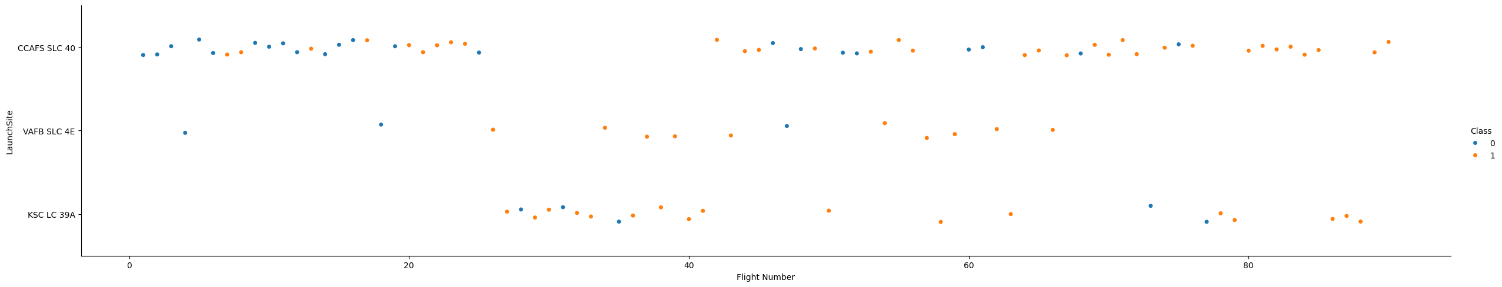
Flight Number vs. Launch Site
Scatter Plot Flight Number vs. Launch Site:

Slide 19
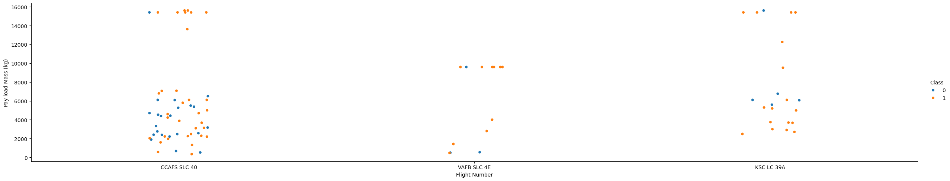
Payload vs. Launch Site
Scatter between Payload and Launch Site

Slide 20
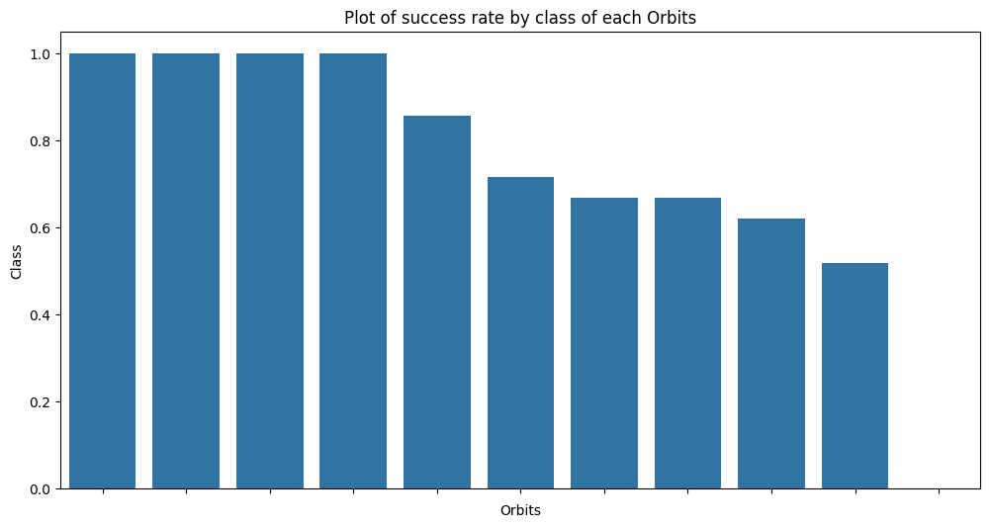
Success Rate vs. Orbit Type

Slide 21
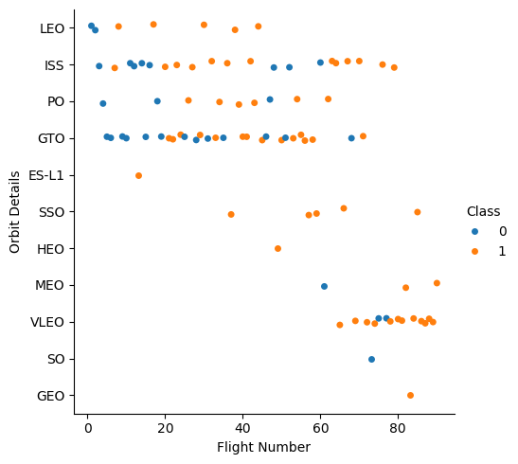
Flight Number vs. Orbit Type
LEO orbit success is related to the number of flights.
GTO orbit, does not seem to have no relationship between flight number and the orbit.

Slide 22
Payload vs. Orbit Type
Heavy payloads seem to be strongly result in successful landing.

Slide 23
Launch Success Yearly Trend
Success rate for obit landing by SpaceX has been increasing from as low as 20% around 2013, and as high as 85% around 2019/2020.

Slide 24
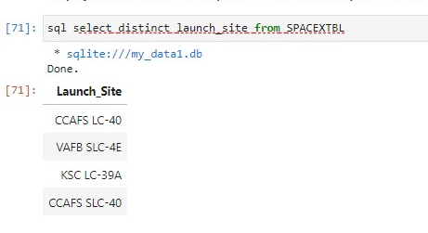
All Launch Site Names
Used key word DISTINCT.
This will to show only unique i.e., launch sites from the SpaceX data in the dataset studied.

Slide 25
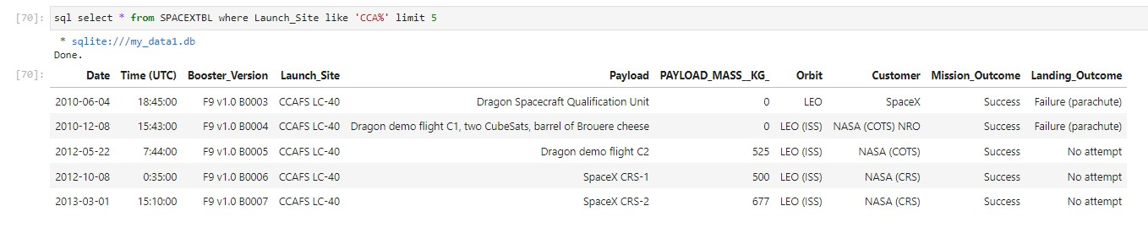
Launch Site Names Begin with 'CCA'
Use the below, with a wild-card to find and display records where launch sites whose names begin with `CCA`

Slide 26
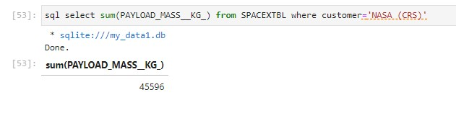
Total Payload Mass
Used the WHERE clause to filter data, and Function ‘Sum’ to find the total payload, and the WHERE clause to filter, the payload carried by boosters from NASA

Slide 27
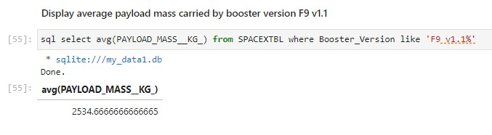
Average Payload Mass by F9 v1.1
Used the AVG function to get the average payload mass carried by booster version F9 v1.1, and this was found to be 2,534.6

Slide 28
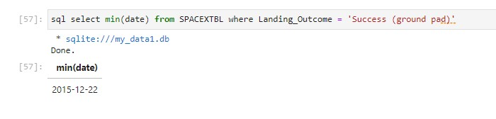
First Successful Ground Landing Date
The date of the first successful landing outcome on ground pad was 22 December 2015.

Slide 29
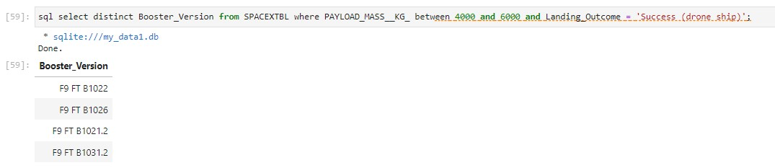
Successful Drone Ship Landing with Payload between 4000 and 6000
Use WHERE clause to filter for boosters which have successfully landed on drone ship.
Used the AND to get an intersection of the second condition, being.
Successful landing with payload mass greater than 4000 but less than 6000

Slide 30
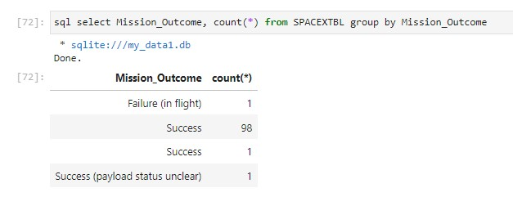
Total Number of Successful and Failure Mission Outcomes
Use the wildcard like ‘%’ to filter for WHERE MissionOutcome was a success or a failure.

Slide 31
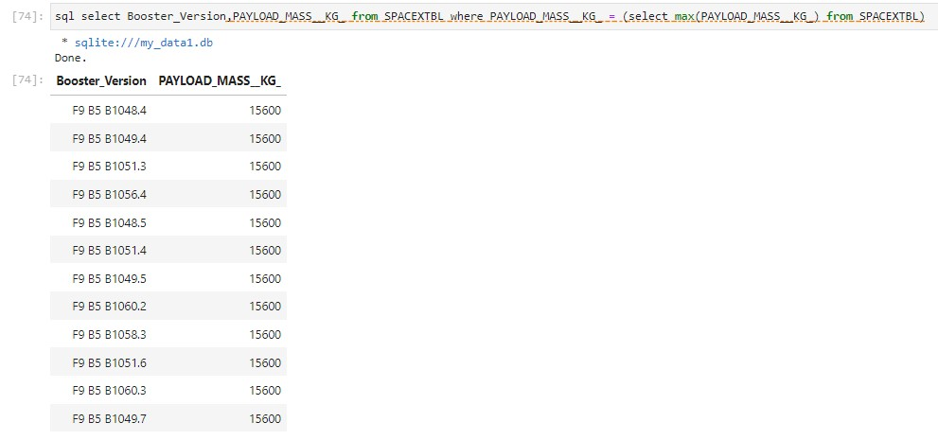
Boosters Carried Maximum Payload
Found the booster that have carried the maximum payload.
This was done through the use of a subquery in the WHERE clause and the MAX() function.

Slide 32
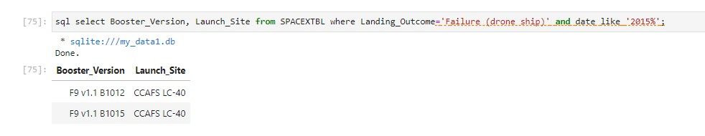
2015 Launch Records
Used a combinations of the WHERE clause, LIKE, AND, and BETWEEN conditions to filter the required.
Being, the filtering of the failed landing outcomes in drone ship, their booster versions, and launch site names for year 2015

Slide 33
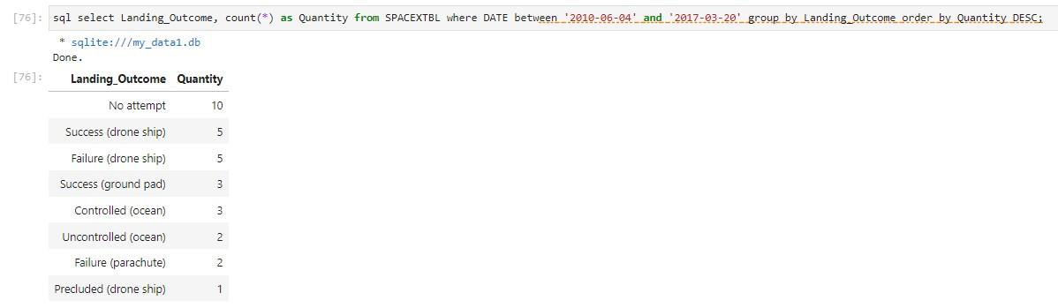
Rank Landing Outcomes Between 2010-06-04 and 2017-03-20
Used the COUNT, WHERE clause and the BETWEEN, GROUP by and ORDER BY to find the required.
COUNT of landing outcomes from the data.
WHERE clause to filter for landing outcomes BETWEEN to filter the by dates i.e. 2010-06-04 to 2010-03-20.
Applying the GROUP BY clause to group the landing outcomes.
Use the ORDER BY clause to order the grouped landing outcome in descending order.

Slide 34

Section 3

Slide 35
SpaceX Launch Sites
The SpaceX launch sites are mainly in the United State of America.
They are on the coastal region.
Closer to the seas.

Slide 36
United States SpaceX Launch Sites
More successes were recorded under the Florida Launch.

Slide 37
SpaceX Launch Proximity
Launch sites are in close proximity to;
Railway, highway and coastline – for easy access of transport and logistics of heavy equipment that maybe be required.
They are far of main cities – as a risk management approach, to minimize fatality when they landing fail.

Slide 38

Section 4

Slide 39

Successful Launches
KSC LC-39A recorded the highest success rate for the period under study.

Slide 40
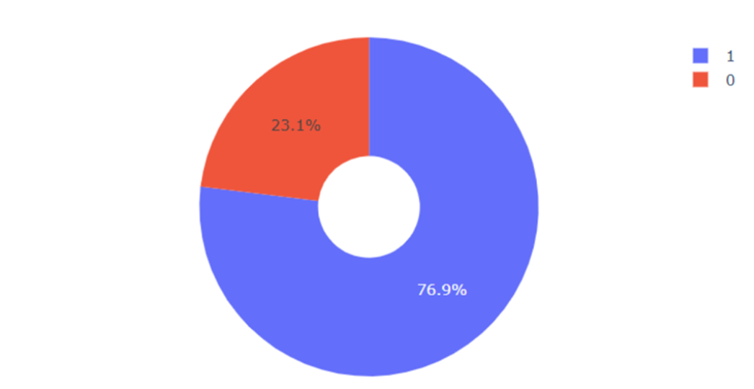
Success vs Failure Rate
KSC LC-39A had the highest success rate of 77% and 23 is failure rate.

Slide 41
Dashboard – Payload vs Launch Outcome
Success rates is high for low weight payloads compared to heavy weighted ones.

Slide 42


Slide 43
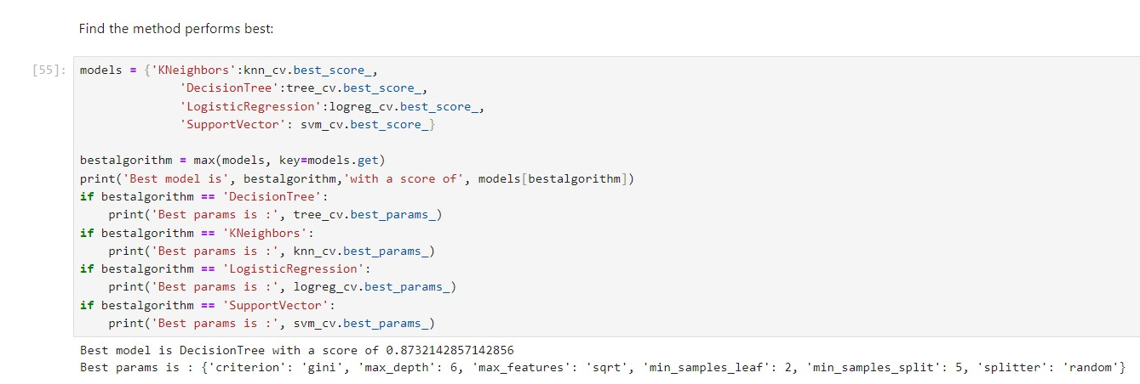
Classification Accuracy
(https://github.com/Sibiya-K/IBM-Applied-Data-Science-Capstone.git)

Slide 44

Confusion Matrix
Confusion matrix for the decision tree classifier indicate that the classifier can distinguish between the different classes.

Slide 45
Conclusions
Landing success increases as the flight counts increase at a launch site – this could be explained by the learning theory where each flight is improved from the previous success or failure.
Landing launch success rate has been on an increase trend since 2013.
Orbits with most success rates areES-L1, GEO, HEO, SSO and VLEO.
KSC LC-39A had the most successful launches of all the other sites

Slide 46
Appendix & References
(https://github.com/Sibiya-K/IBM-Applied-Data-Science-Capstone.git)

Slide 47


